Slide 1
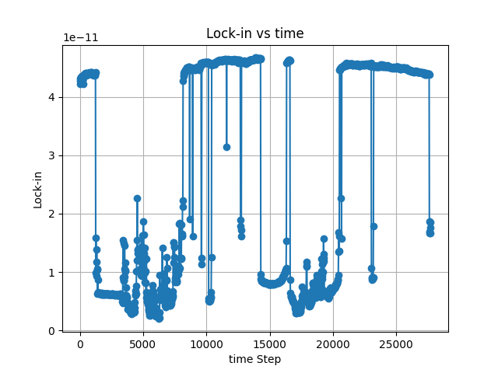
A B C D
Distance per 1K step : 0.1136mm
A : Lock-in:4.420E-11,Capacitance 1:0.85444 ,Step count:1240
B : Lock-in:4.268E-11,Capacitance 1:0.6817 ,Step count:8160
C : Lock-in:4.655E-11,Capacitance 1:0.6509 ,Step count:14280
D : Lock-in:4.457E-11,Capacitance 1:0.6365 ,Step count:20520

Slide 2
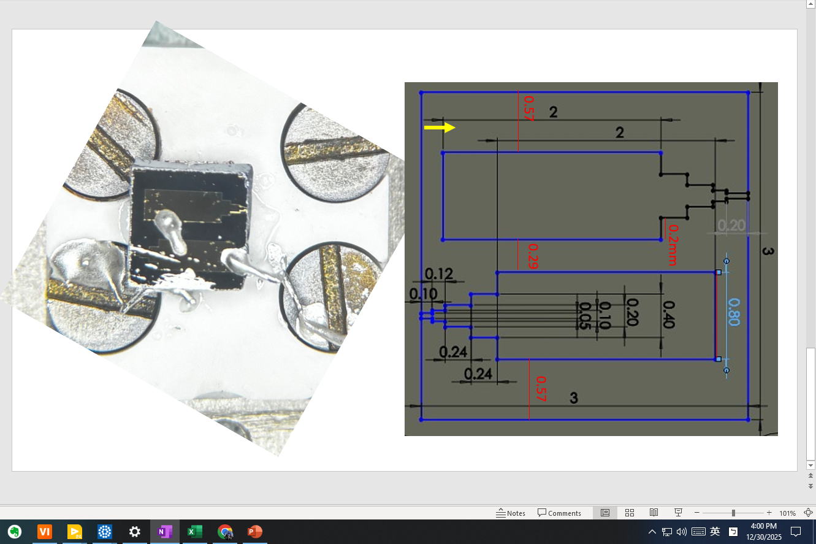

Slide 3
3mm
0.5mm
0.5mm
0.5mm
0.25mm
0.5mm
0.5mm
3mm
0.5mm
0.5mm
0.5mm
0.25mm
0.25mm
0.5mm
0.5mm
0.25mm

Slide 4
3mm
0.75mm
0.5mm
0.75mm
0.25mm
0.75mm
0.25mm
0.5mm
3mm
0.25mm
0.75mm
0.25mm
0.25mm
0.25mm
0.25mm
0.25mm

Slide 5
3mm
0.75mm
0.5mm
0.75mm
0.75mm
0.25mm
0.5mm
3mm
0.25mm
0.75mm
0.5mm
0.5mm
0.25mm
0.25mm

